Slide 1
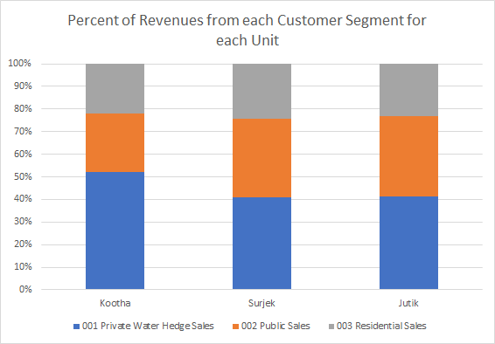
Segmentation of the revenues by unit, reveals that of the three (3) customer segments, Private Water Hedge Sales are the most popular, followed by Public Sales ($146.9M) and lastly Residential Sales ($102.5M).

Slide 2
Of the ($436.8M)¹ in Revenue Sales over the July-2013 to June-2014 Period, Surjek provides close to 50% of Sales Volumes ($202M), with Jutik ($ 163.6 M) and Kootha ($70.9) providing the remaining.

Slide 3
Targeted Expense Analysis reveals an interesting trend; Overall Costs sharply increase from December, with Surjek, contributing $179.3M (55.8%) towards the overall cost-base.

Slide 4
Targeted Expense Analysis reveals an interesting trend; Overall Costs sharply increase from December, with Labor Costs, contributing $87M (27%) towards the overall cost-base.

Slide 5
Further analysis singles-out Surek with $179M (55.8%) worth of expenses, contrasted to a much lower spend from Kootha ($51 M) and Jutik ($90.7M), largely due to lower Chemical and Labour Expenditure.

Slide 6
Drilling-down to the cost-element level, reveals an indicative relationship between water production and chemical expenditure with this being particularly pronounced for the Surjek Unit which coincidentally has the highest rate of water production.

Slide 7
Concluding our analysis, Jutik has the highest overall EBIT contributions ($72.9 M), followed by Surjek ($22.9 M) , and lastly Kootha ($19.7 M). However, from an EBIT Margin (%) perspective, Kootha has a higher margin than that of Surjek, indicative of a lower revenue-to-expense ratio.¹
Note:¹ We can clearly see for Surjek over the October, November and May Periods – expenses were far higher than revenues which contributed to this lower revenue-to-expense ratio.

Slide 8
With an estimated 24.26% reduction in Surjek’s Revenues ($49 M) due to the Maintenance Outage, Quarter 2 presents the best balance of revenue-loss mitigation with respect to market pricing, as opposed to Quarter 1 which represents the highest demand (2273 GL) and Water Balancing Market Prices ($84.84).

Slide 9
Of the three Desalination Plants, all three remain profitable at current market prices by a favourable margin; Clearly Surjek is the most cost-effective $54.23/ML) followed by Jutik ($35.80/ML) and lastly Kootha ($25/ML) which is consistent across the July-2013 to June-2014 period.

Slide 10
Contrasting the Cost to Produce against the Volume of Water Produced highlights clear economy of scale with costs rapidly dwindling across all plants as volume surges, with this being particularly noticeable across the Kootha and Surjek Plants with costs dropping as much as 50%.

Slide 11
Drilling down further from a product-perspective, reveals two different patterns of elasticity, where hard water tends to be relatively price elastic regardless of quantity purchased, whilst soft water is more representative of an inelastic price-to-volume relationship.

Slide 12
Lastly, when viewing the economic pricing data from a micro-perspective, it is indicative that Hard Water is seen as more of a ‘less core’ product than that of Soft Water whose price remains largely flexible.

